Slide 1



Unsupervised Models
INTRODUCTION TO MACHINE LEARNING
- Ashwina Rakish

Slide 2
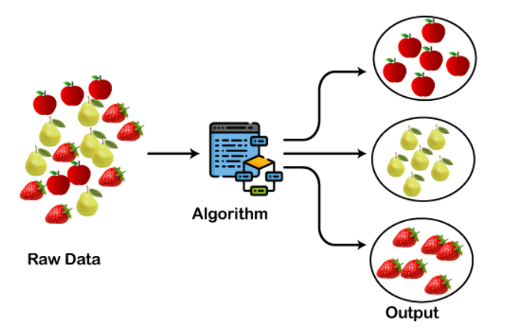
Clustering
Clustering is a set of techniques used to partition data into groups, or clusters. Clusters are loosely defined as groups of data objects that are more similar to other objects in their cluster than to data objects in other clusters. Clustering refers to a very broad set of techniques for finding subgroups or clusters in a data set. Clustering is an unsupervised learning method, meaning that it doesn't require labeled data for training.

Slide 3
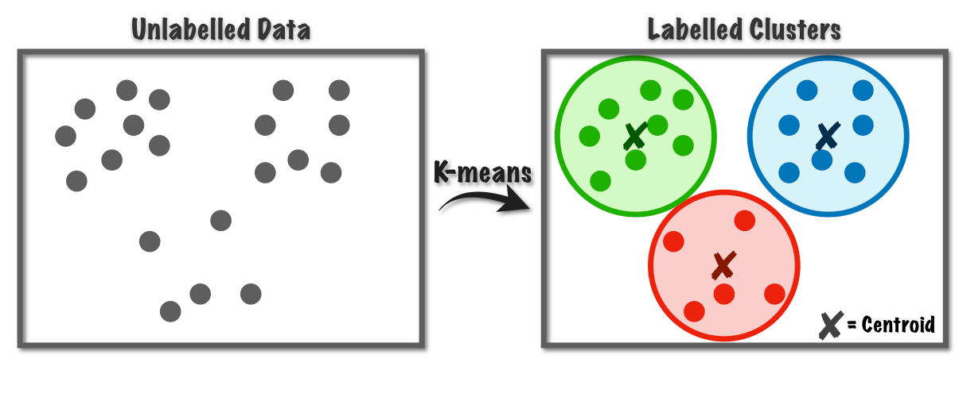
K means Clustering
1) Initial centroid for each cluster is randomly picked.
2) Points are assigned to each cluster based on distance. 3) New centroids are calculated using the mean of data points assigned.
Disadvantage: Poor initial centroids may lead to slower convergence or suboptimal clustering results.

Slide 4
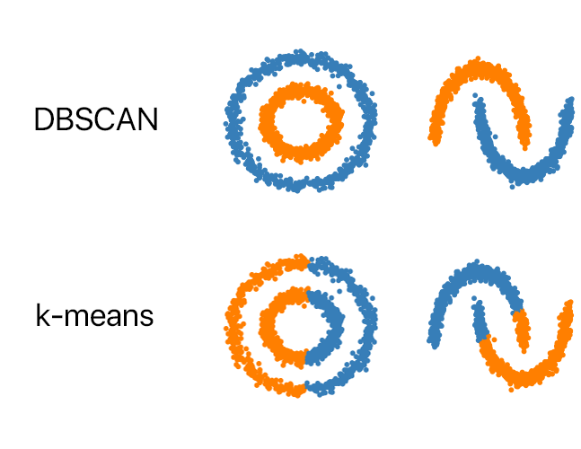
DBSCAN
DBSCAN defines clusters based on the density of data points. It categorizes data points into three main types:
Core Points: A core point is a data point that has at least a specified number of neighboring points (MinPts) within a given radius (epsilon).
Border Points: Border points are not core points themselves but lie within the neighborhood of a core point.
Noise Points: Noise points are data points that do not belong to any cluster.
Epsilon (ε): The maximum radius that defines the neighbourhood around a data point. MinPts: The minimum number of data points required to form a cluster.

Slide 5
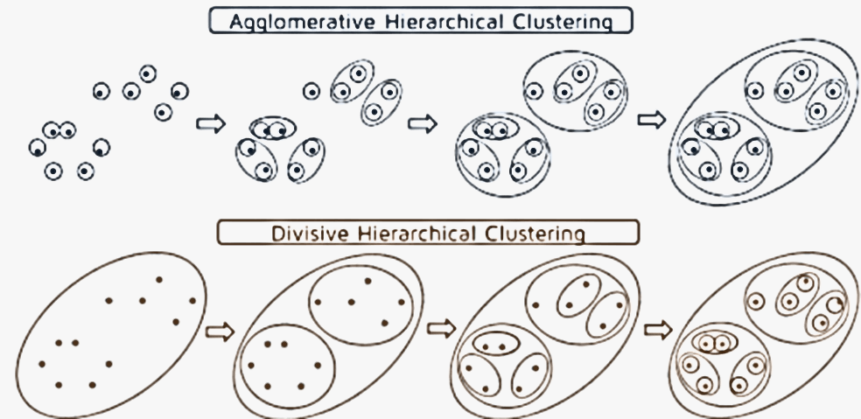
Hierarchical Clustering
Hierarchical clustering is a method of clustering data points into a hierarchy of clusters. It starts by considering each data point as a separate cluster and then iteratively merges clusters based on their similarity until all data points belong to a single cluster or until a predetermined number of clusters is reached.

Slide 6
QUIZ

Slide 7
Question: Will choosing different centroids change the clustering in K means?
Answer: Yes, Clustering changes based on centroid

Slide 8
Question: What kind of clustering uses merging smaller clusters?
Answer: Hierarchical Clustering

Slide 9

Question: Is the given figure using K means or DBSCAN?
Answer: K-means

Slide 10

Question: Is the given figure using K means or DBSCAN?
Answer: DBSCAN

Slide 11
Question: Which of the following is required by K-means clustering? a) defined distance metric b) number of clusters c) initial guess as to cluster centroids d) all of the mentioned
Answer: d)

Slide 12
Question: Which clustering algorithm does not require specifying the number of clusters in advance? a. K-Means b. DBSCAN c. Agglomerative d. All of the above
Answer: b)

Slide 13
Question: Which clustering algorithm is capable of detecting outliers as noise points? a. K-Means b. DBSCAN c. Agglomerative d. All of the above
Answer: b)

Slide 14
Thank You!

